Slide 1

Chapter 7 & 8
Business and Financial Analysis
© McGraw Hill LLC. All rights reserved. No reproduction or distribution without the prior written consent of McGraw Hill LLC.
Notes:
We continue in Part Three, Establishing a Financial Foundation, with Chapter Eight, Business and Financial Analysis.

Slide 2
Ratio Analysis
Series of ratios along four areas of company performance that provides a picture of the health of the company.
Areas of company performance:
  Liquidity
  Activity
  Leverage
  Profitability
Notes:
Learning Objective 8-4: Explain ratio analysis.
Ratio analysis is a tool for the entrepreneur to use to examine the overall health of the organization.
Ratios by themselves are of little value unless they are evaluated in comparison to those of other similar organizations, an industry average, or simply the previous month’s or year’s performance.
The text will discuss four basic categories of performance ratios: liquidity, activity, leverage, and profitability.
A summary of all the ratios are listed in Figure 8.4 of the text.
The text will first provide the means by which these ratios are calculated and then provide some insights that each brings to the business owner.

Slide 3
Liquidity Ratios
Ratios that measure the short-term ability of the firm to meet its obligations.
Financial liquidity is critical for success.
Notes:
Learning Objective 8-4: Explain ratio analysis.
Financial liquidity is critical to the success of the firm.
Liquidity ratios measure the short-term ability of the firm to meet its obligations.
These obligations would include debt or accounts payable that must be paid by the business in the near term.
Financing institutions generally require that liquidity ratios be kept within certain ranges.
If the business drops below the lower bounds of its liquidity level, then the bank may limit the line of credit to the firm or require a higher interest rate on the debt because the risk position of the firm will have increased.
Even for companies that appear to be growing well and have good prospects, the ability to meet the short-term obligations of the firm is a significant concern.

Slide 4
Commonly Used Ratios: Liquidity
Current (Current Assets = Cash + Accounts Receivable + Inventory) | Current Assets ÷ Current Liabilities
Quick (or Acid Test) | Current Assets − Inventory ÷ Current Liabilities
The following content is arranged like a table.
Notes:
Learning Objective 8-4: Explain ratio analysis.
Two specific types of liquidity ratios are of interest:
Current Ratio: Current Assets divided by Current Liabilities.
(Note: Current assets = Cash + Accounts Receivable + Inventory)
The current ratio measures those assets that can be quickly turned into cash and used to pay for immediate liabilities. In general, this is the cash balance of the firm plus inventory divided by all short-term liabilities.
Quick (Acid) Ratio: Current Assets minus Inventory divided by Current Liabilities.
The quick ratio removes the ability to sell inventory and examines the pure cash position relative to the current liabilities.
The term used here is quick ratio, but it is also sometimes referred to as acid test.

Slide 5
Activity Ratios
Ratios that measure the efficiency with which an entrepreneur is handling the resources of the business.
Specific ratios:
Inventory turnover
Account receivable turnover
Total/fixed asset turnover
Notes:
Learning Objective 8-4: Explain ratio analysis.
Activity ratios measure the efficiency with which you are handling the resources of the business.
They are particularly helpful as the business develops, since you will be able to compare from month to month.
There are three specific ratios of interest:
Inventory turnover
Account receivable turnover
Total/fixed asset turnover

Slide 6
Commonly Used Ratios: Activity
Inventory Turnover | Cost of Goods Sold ÷ Inventory
Accounts Receivable Turnover | Net Credit Sales ÷ Accounts Receivable
Fixed Asset Turnover | Net Sales ÷ Fixed Assets
The following content is arranged like a table.
Notes:
Learning Objective 8-4: Explain ratio analysis.
Inventory Turnover: Cost of Goods Sold divided by Inventory.
Cost of Goods Sold is the direct costs involved with a product.
As this inventory turnover rises, the firm is getting closer to a just-in-time system.
Generally, an inventory turnover ratio that is better than the industry average or one that is improving each month means that the firm is operating more efficiently.
Account Receivable Turnover: Credit Sales divided by Accounts Receivable.
This metric examines how fast the company turns credit sales into cash.
The faster the firm is able to turn credit sales into cash, the better the cash flow position of the firm is.
We will discuss this topic more when we examine collections at the end of this chapter.
Total/Fixed Asset Turnover: Net Sales divided by Fixed Assets or Net Sales divided by Total Assets.
Entrepreneurial businesses will likely use one of these numbers more often than the other. The difference principally turns on whether or not the business has large amounts of fixed assets.
For example, a small manufacturer will want to focus on the productivity of its fixed assets, while in contrast, a retail store will be more interested in total assets.
In either case, the founder is attempting to examine the ability to generate sales from the assets employed by the organization.
As this number increases, the firm is being more efficient.

Slide 7
Leverage Ratios
Ratios that are used to examine the relative level of indebtedness of the entrepreneurial business.
High levels of debt are dangerous when the economy turns down
Ratios of interest:
Debt-to-equity
Debt-to-assets
Times interest earned
Notes:
Learning Objective 8-4: Explain ratio analysis.
Leverage ratios are used to examine the relative level of indebtedness of the entrepreneurial business.
Specifically, all creditors want to ensure that the entrepreneurial business has the ability to generate sufficient funds to pay their loans.
High levels of debt are dangerous when the economy turns down.
Three ratios are commonly used to evaluate the relative level of indebtedness of a business: Debt-to-equity, debt-to-assets, and times interest earned.

Slide 8
Commonly Used Ratios: Leverage
Debt to Equity | Total Liabilities ÷ Total Assets − Total Liabilities
Debt to Assets | Total Liabilities ÷ Total Assets
Times Interest Earned | Operating Income ÷ Interest
The following content is arranged like a table.
Notes:
Learning Objective 8-4: Explain ratio analysis.
The three leverage ratios.
Debt-to-Equity: Total Liabilities divided by Total Assets minus Total Liabilities.
The denominator of this equation (Total Assets minus Total Liabilities) is effectively the owner’s equity.
This ratio provides the information on the portion of the business owned by the lenders and that portion owned by the founder(s).
Debt-to-Assets: Total Liabilities divided by Total Assets.
A slight variation of the debt-to-equity ratio, this measures the percentage of the assets of the firm that are actually owned by the creditors.
Times Interest Earned: Operating Income divided by Interest.
This figure estimates the number of times that the firm could repay the current interest owed on its debts.
The higher this number is, the more capable the firm is of servicing its debt load.

Slide 9
Profitability Ratios
  Ratios that examine the performance of a firm and its ability to make economic rents over and above its costs.
  Profitability is the outcome of a business’s other activities.
  Five ratios of interest:
  Gross profit margin
  Operating profit margin
  Net profit margin
  Return on assets or ROA
  Return on equity or R O E
Notes:
Learning Objective 8-4: Explain ratio analysis.
Profitability should be recognized as an outcome of the business’s other activities.
Thus, profitability is a result of effectively managing the assets and cash flow of the firm, not the activity of focus itself.
Profitability ratios examine the performance of the firm and its ability to make economic returns over and above its costs.
There are five profitability ratios that generate the greatest attention, and they are gross profit margin, operating profit margin, net profit margin, return on assets (ROA), and return on equity (ROE).

Slide 10
Commonly Used Ratios: Profitability
Gross Profit Margin | Gross Profit ÷ Net Sales
Operating Profit Margin or EBIT | Operating Income ÷ Net Sales
Net Profit Margin | Net Profit ÷ Net Sales
Return on Assets or ROA | Net Profit ÷ Total Assets
Return on Equity or R O E | Net Profit ÷ Equity (Total Assets − Total Liabilities)
The following content is arranged like a table.
Notes:
Learning Objective 8-4: Explain ratio analysis.
The five profitability ratios are as follows.
Gross Profit Margin: Gross Profit divided by Net Sales.
This ratio is used to determine the overall profit that is obtained from all sales during the period being evaluated.
Gross profit is a category created by subtracting returned merchandise and the direct costs of the goods sold from the firm’s the total net sales.
This is the most basic of the profitability measures.
Operating Profit Margin: Operating Income divided by Net Sales.
A finer-grained measure, this looks at the gross profit minus all of the operating expenses.
This figure is also known as Earnings before Interest and Taxes (EBIT) and represents the operating efficiency of the organization.
Net Profit Margin: Net Profit divided by Net Sales.
Net profit is the bottom-line calculation from the income statement.
This figure presents a picture of the relative margin earned after considering all obligations and expenses.
Return on Assets (ROA): Net Profit divided by Total Assets.
This is one of the two overall calculations that are standards in almost any industry.
This ratio examines the ability of the firm to return an overall profit compared to the amount of assets that the firm has invested into the effort.
Return on Equity (ROE): Net Profit divided by Equity (Total Assets minus Total Liabilities).
This ratio is used to provide all investors an evaluation of how much each dollar of their investment is generating in profit.

Slide 11
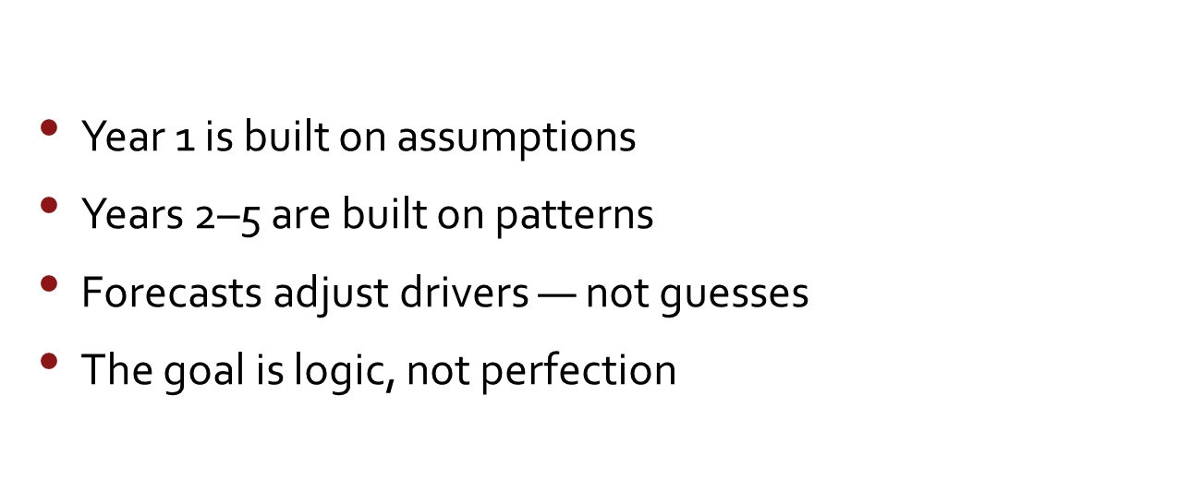
5-Year Financial Forecast Roadmap for Startups
The Big Picture

Slide 12
Step 1: Build a Realistic Year 1
Conservative revenue assumptions
All real expenses included (especially owner pay)
Understand break-even point
If Year 1 fails, future years won’t work

Slide 13
Step 2: Identify Key Financial Drivers
Customer growth
Average revenue per customer (ARPU)
Cost of goods sold (COGS %)
Fixed vs variable expenses
Hiring and payroll timing

Slide 14
Driver #1: Customer Growth
Forecast number of customers per year
Apply realistic growth rates
Growth compounds over time
Avoid guessing total revenue

Slide 15
Driver #2: Revenue per Customer (ARPU)
Price increases
Repeat purchases
Upsells or subscriptions
Small increases create a big impact over time

Slide 16
Driver #3: Cost of Goods Sold (COGS)
Usually improves slightly with scale
Do not assume major efficiency gains early
Track as a percentage of revenue
Critical for gross margin

Slide 17
Driver #4 & #5: Expenses
Fixed expenses grow slowly or step up
Variable expenses scale with revenue
Marketing, fulfillment, processing fees
Expenses should follow logic, not hope

Slide 18
Driver #6: Hiring & Payroll
Payroll is usually the largest expense
Hiring happens in steps, not gradually
Each hire must justify revenue impact
Most startups scale too fast here

Slide 19
Step 3: Project Years 2–5
Adjust only the drivers
Keep structure consistent year to year
Let math do the work
Explain every change clearly

Slide 20
Step 4: Revisit Break-Even Each Year
Break-even changes as fixed costs increase
Higher revenue doesn’t always mean profitability
Understand minimum sales needed
Avoid growing into losses

Slide 21
Step 5: Stress-Test the Model
Base case: realistic growth
Conservative case: slower revenue
Aggressive case: higher costs
Forecasting is risk management

Slide 22
What Investors and Banks Look For
Clear assumptions
Logical growth patterns
Cost awareness
Understanding of cash flow

